Slide 1
The Fundamental of Mobile Robot
Machine Perception and Interaction Group (MPIG)
assignments.shmtu@gmail.com

Slide 2
Send an email with specified subject ‘Robot stuff’ to
assignments.shmtu@gmail.com
An automatic reply will come.
All you need would be included!

Slide 3

assignments.shmtu@gmail.com

Slide 4


All the codes accompanying this course are open-sourced at Github.
The project homepage:
https://github.com/sunzuolei/robotcourse
The git repository:
https://github.com/sunzuolei/robotcourse.git
Learn more about git:
http://en.wikipedia.org/wiki/Git_(software)
The best GUI-based git client on Windows:
https://code.google.com/p/tortoisegit/

Slide 5
Localization with Histogram Filter

Slide 6

Our robot has no clue where it is.

Slide 7

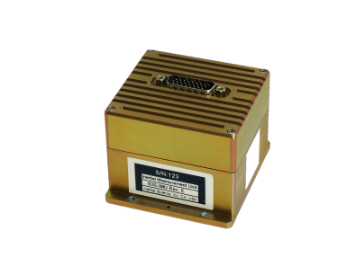
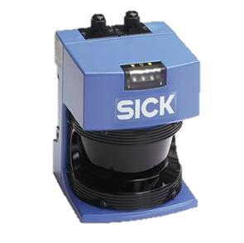

Our robot has no clue where it is.
GPS-liked localizer is not reliable.
We need sensors and the algorithms
for data cooking.

Slide 8
Let's assume there are 3 different landmarks in the world. they all look alike, so they're not distinguishable, but robot can distinguish the door from the non-door area--from the wall.

Slide 9
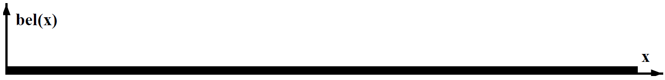
Uniform function assigns equal weight to every possible place where the robot might be.
bel stands for belief. You may treat it as probability.

Slide 10
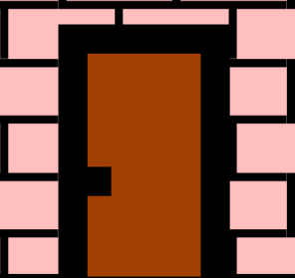
By sensing with a camera, the robot knows that it is now located, likely, next to a door.

Slide 11
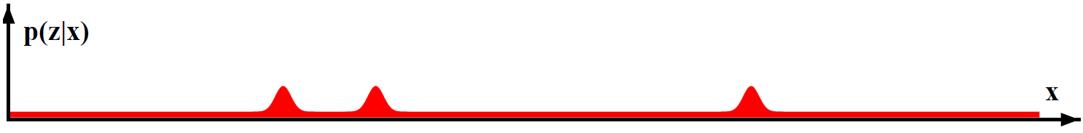
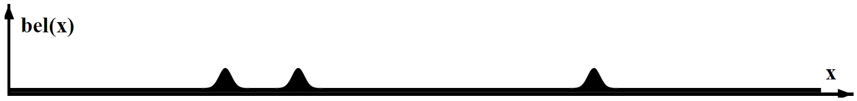

Slide 12
Robot moves to the right by a certain distance. And It knows roughly how far it moved.

Slide 13
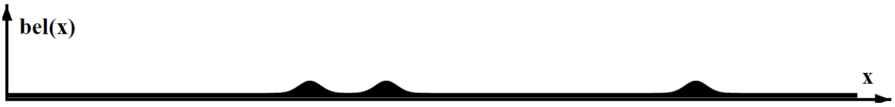
Convolution
The belief is shifted according to the motion. Now, robot motion is somewhat uncertain. We can never be certain where the robot moved. So these bumps are a little bit flatter than they were.

Slide 14
The robot senses again with its camera.

Slide 15
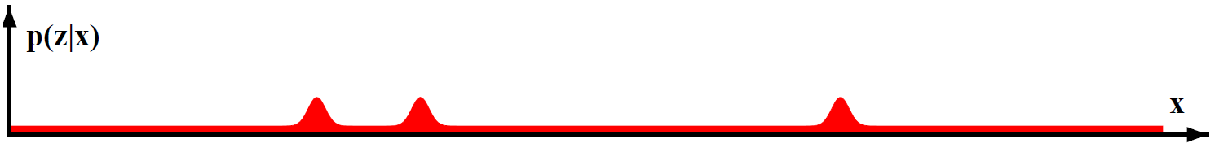

How will the belief like?

Slide 16
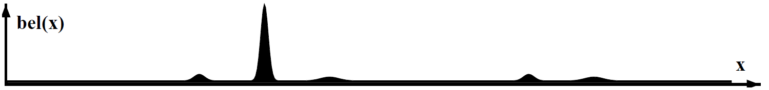
The robot has localized itself!!

Slide 17
It is a core aspect of
localization especially
of mobile robot!

Slide 18
Prior
Observation model / Sensor model
Posterior

Slide 19
Prior
The probability before considering data (measurement)
Posterior
The probability after data (measurement) has been taken.

Slide 20
Prior
Observation model / Sensor model
Posterior
Process model / Motion model
Observation model / Sensor model
Posterior

Slide 21
Prior
Observation model / Sensor model
Update / Measurement update
Posterior
Predict / Process update
Process model / Motion model
Observation model / Sensor model
Update / Measurement update
Posterior

Slide 22
Update / Measurement update
Prior
Posterior
Predict / Process update

Slide 23
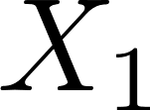
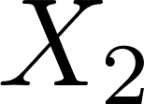
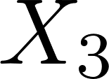
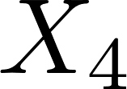
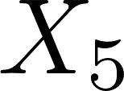
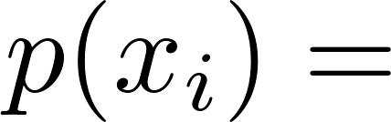
A world with 5 different cells or places
What is the probability of any of those x's?

Slide 24
0.2
A world with 5 different cells or places
What is the probability of any of those x's?
The total probability equals 1

Slide 25
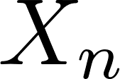
…
A world with n different cells or places
What is the probability of any of those x's?

Slide 26
…
1/n
A world with n different cells or places
What is the probability of any of those x's?
Let’s implement this！

Slide 27
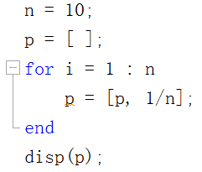
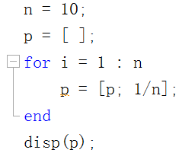
…
OR
What’s the difference?
Are they problematic?
P1

Slide 28
…
Explanation The size of the indicated variable or array appears to be changing with each loop iteration. Commonly, this message appears because an array is growing by assignment or concatenation. Growing an array by assignment or concatenation can be expensive. For large arrays, MATLAB must allocate a new block of memory and copy the older array contents to the new array as it makes each assignment. Programs that change a variable's size in this way can spend most of their run time in this inefficient activity.
For the same reasons, there is significant overhead in shrinking an array or in changing the size of a variable on each iteration.
P1

Slide 29
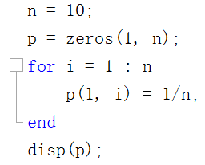
…
P1

Slide 30
0.2
0.2
0.2
0.2
0.2
Now that we can establish the robot's initial belief about its location in the world, we want to update these beliefs given a measurement from the robot's sensors.

Slide 31
0.2
0.2
0.2
0.2
0.2
Let's assume 2 of those cells are colored red whereas the other 3 are green.

Slide 32
0.2
0.2
0.2
0.2
0.2
Red cell * 0.6
Green cell *0.2
Sensors are incorrect, so we do not want to multiply the green cell probability by zero. Instead, we multiply it by 0.2!

Slide 33
Red * 0.6
Green *0.2
0.2
0.2
0.2
0.2
0.2
What are the probabilities that the robot is in a red cell and the green cell?

Slide 34
Red * 0.6
Green *0.2
0.2
0.2
0.2
0.2
0.2
0.04
0.12
0.12
0.04
0.04
Find the probability for each cell by multiplying the previous by the new factor, whose value depends on the color of the cells.

Slide 35
Red * 0.6
Green *0.2
0.2
0.2
0.2
0.2
0.2
0.04
0.12
0.12
0.04
0.04
Is this a valid probability distribution?

Slide 36
Red * 0.6
Green *0.2
0.2
0.2
0.2
0.2
0.2
0.04
0.12
0.12
0.04
0.04
0.04*3+0.12*2 = 0.36
NO! they do not add up to one.

Slide 37
Red * 0.6
Green *0.2
0.2
0.2
0.2
0.2
0.2
0.04
0.12
0.12
0.04
0.04
0.04*3+0.12*2 = 0.36
How can we normalize it?

Slide 38
Red * 0.6
Green *0.2
0.2
0.2
0.2
0.2
0.2
0.04
0.12
0.12
0.04
0.04
1/9
1/3
1/3
1/9
1/9
0.04*3+0.12*2 = 0.36
Divide each of them by the sum!

Slide 39
Red * 0.6
Green *0.2
0.2
0.2
0.2
0.2
0.2
0.04
0.12
0.12
0.04
0.04
1/9
1/3
1/3
1/9
1/9
Which is prior and posterior?

Slide 40
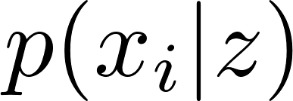
Red * 0.6
Green *0.2
Prior
0.2
0.2
0.2
0.2
0.2
1/9
1/3
1/3
1/9
1/9
Posterior
The posterior distribution of robot being at place x_i given measurement Z.
Conditional probability

Slide 41
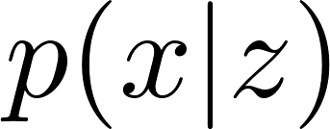
Often, random variables carry information about other random variables. Suppose we already know that Z ’s value is z, and we would like to know the probability that X’s value is x conditioned on that fact.
Conditional probability

Slide 42
Observation model
Red * 0.6
Green *0.2
Prior
0.2
0.2
0.2
0.2
0.2
1/9
1/3
1/3
1/9
1/9
Posterior
Z
Let’s implement this！

Slide 43
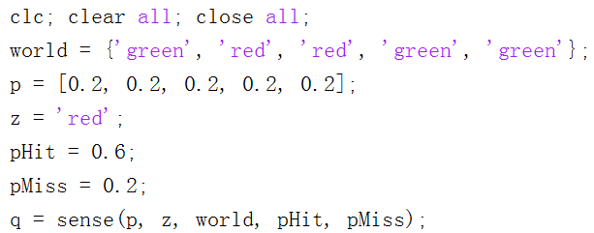
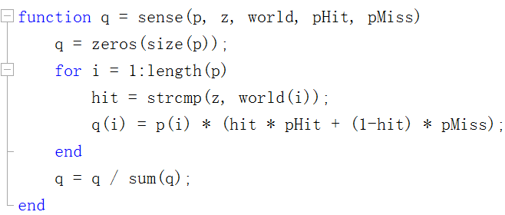
P2

Slide 44
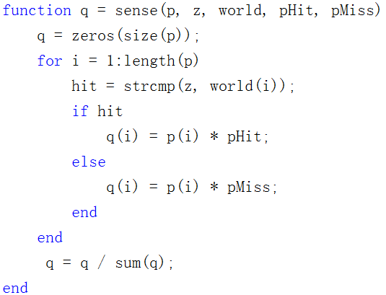
P2

Slide 45
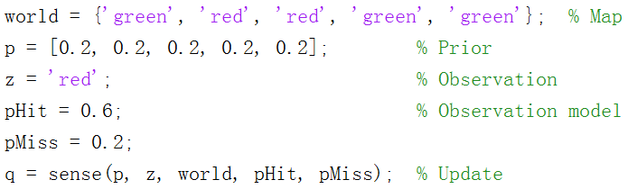
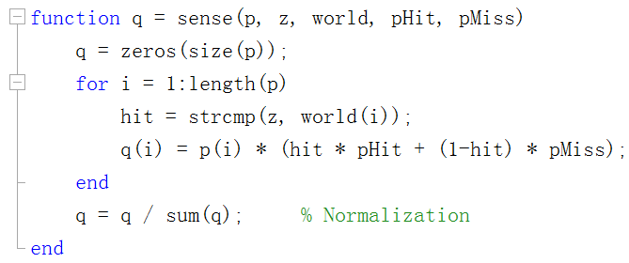
P2

Slide 46
P2

Slide 47
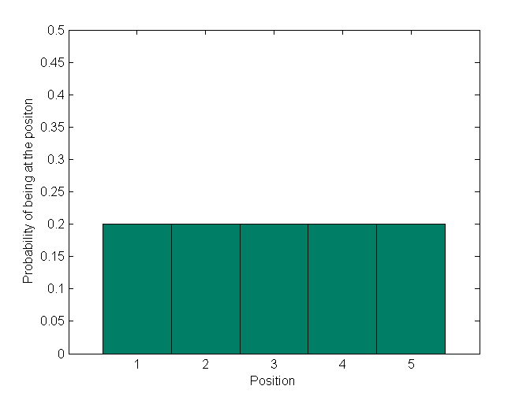
Prior

Slide 48
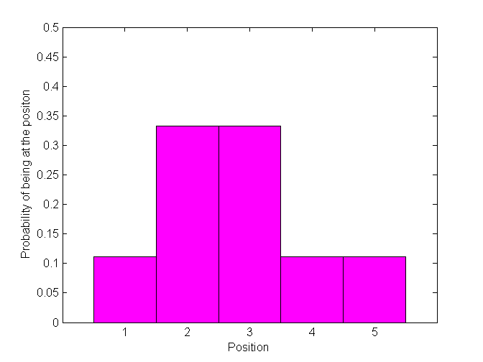
Posterior

Slide 49
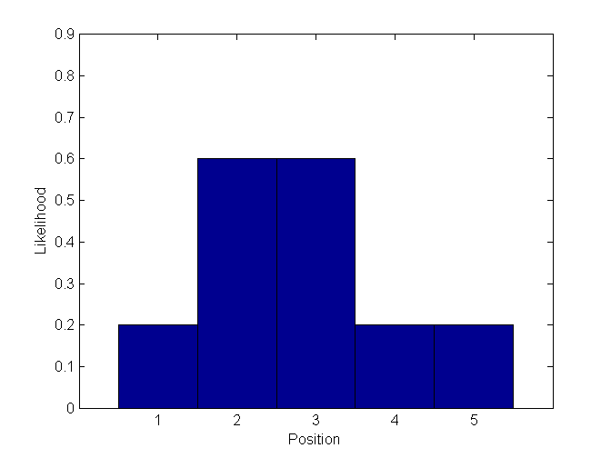

Slide 50

Red * 0.6
Green *0.2
Green* 0.6
Red *0.2
Z
Z
Let’s modify the code to deal with multiple measurements!

Slide 51
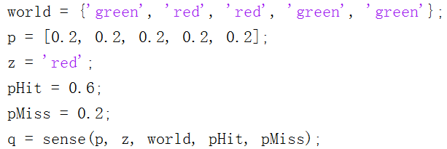
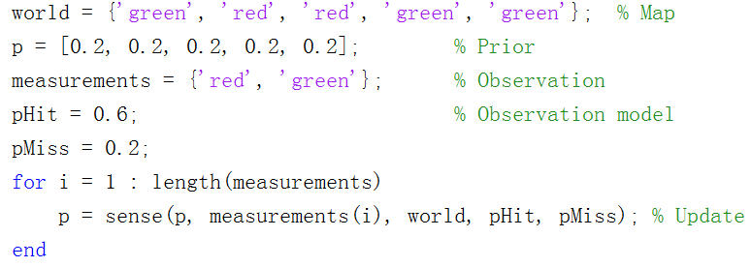
P3

Slide 52
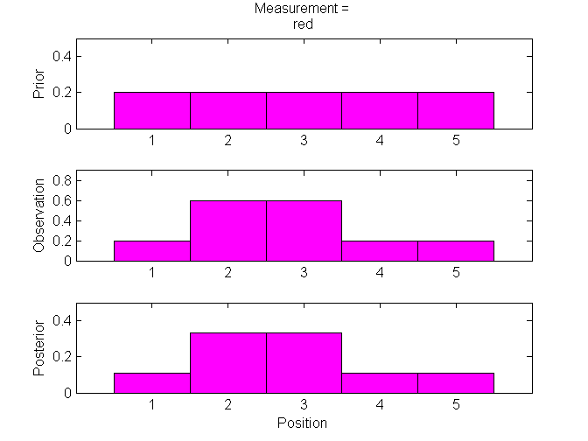
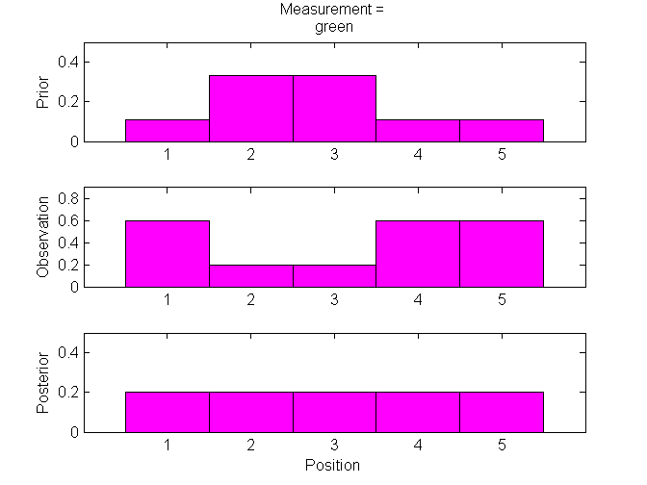
Why is the uniform distribution achieved finally?
P3

Slide 53
P3
Red * 0.6
Green *0.2
Red * 0.6
Green *0.2
Z
Z
Run the code to see the final posterior distribution!

Slide 54
P3
Red * 0.6
Green *0.2
Red * 0.6
Green *0.2
Green* 0.6
Red *0.2
Z
Z
Z
Run the code to see the final posterior distribution!

Slide 55
Implement robot motion…

Slide 56
1/9
1/3
1/3
1/9
1/9
We know the robot moves to the right, and will assume the world is cyclic. So, when the robot reaches the right-most cell, it will circle around back to the first, or left-most cell.

Slide 57
1/9
1/3
1/3
1/9
1/9
Assuming the robot moves exactly one position to the right, what is the probability distribution after the motion?

Slide 58
1/9
1/3
1/3
1/9
1/9
1/9
1/9
1/3
1/3
1/9
Let’s implement this！
Every grid shifts to the right one cell.

Slide 59
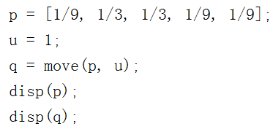
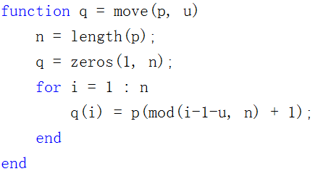
P4
Circular convolution

Slide 60
1/9
1/3
1/3
1/9
1/9
1/9
1/9
1/3
1/3
1/9
Accurate motion
Let’s see inaccurate motion

Slide 61
U = 1
U = 2
0.1
0.8
0.1
Assume the robot executes its action with high probability (0.8), correctly; with small probability (0.1) it will overshoot or undershoot. Note that this is a more accurate model of real robot motion.

Slide 62
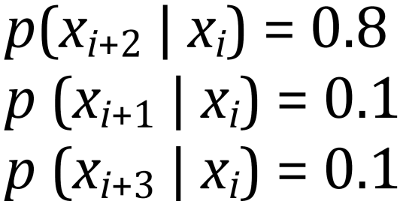
The distribution after the motion given a prior distribution:
U = 2
0.1
0.8
0.1
It is the primary reason why localization is hard, because robots are not very accurate.

Slide 63
0
1
0
0
0
U = 2
What is the distribution after motion?

Slide 64
0
1
0
0
0
0
0
0.1
0.8
0.1
U = 2
As expected, the probability distribution has shifted and spread out. Moving causes a loss of information.

Slide 65
0
0.5
0
0.5
0
Let’s do this again for a different distribution. It is a cyclic motion model as before. What is the posterior?

Slide 66

0
0.5
0
0.5
0
0
0
0.05
0.4
0.05
U = 2
Is this correct?
We answer this in the same way as in the previous question.

Slide 67
0
0.5
0
0.5
0
0.4
0.05
0.05
0.4
0.05
0.05
U = 2
0.4
0.05
0.05
0.4
0.1
Let’s implement this！
We answer this in the same way as in the previous question, but this time we have to take into account that cell 5 can be arrived at in 2 ways: by cell 4 undershooting or cell 2 overshooting.

Slide 68
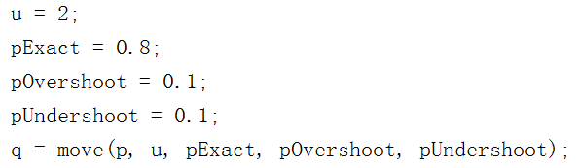
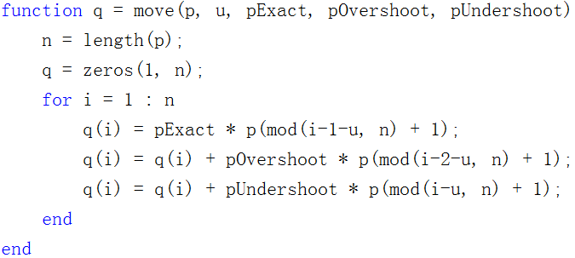
P5

Slide 69
U = 2
0.2
0.2
0.2
0.2
0.2
0.2
0.2
0.2
0.2
0.2
Realize that if we start with a uniform prior distribution (state of maximum confusion), and we then move, we MUST end up with the uniform distribution. Since this problem starts with a state of maximum confusion and then moves (which, remember, never increases our knowledge of the system), we must remain in the maximally confused state.

Slide 70
Let’s implement this！ Robot moves 100 steps without sensing.
1
0
0
0
0
U = 1
What happens if the robot never senses but executes the motion to the right forever, what will be the limit or stationary distribution in the end?

Slide 71
p = [1, 0, 0, 0, 0];
u = 1;
step = 100;
pExact = 0.8;
pOvershoot = 0.1;
pUndershoot = 0.1;
for i = 1 : step
p = move(p, u, pExact, pOvershoot, pUndershoot);
disp(i);
disp(p);
end
P6

Slide 72
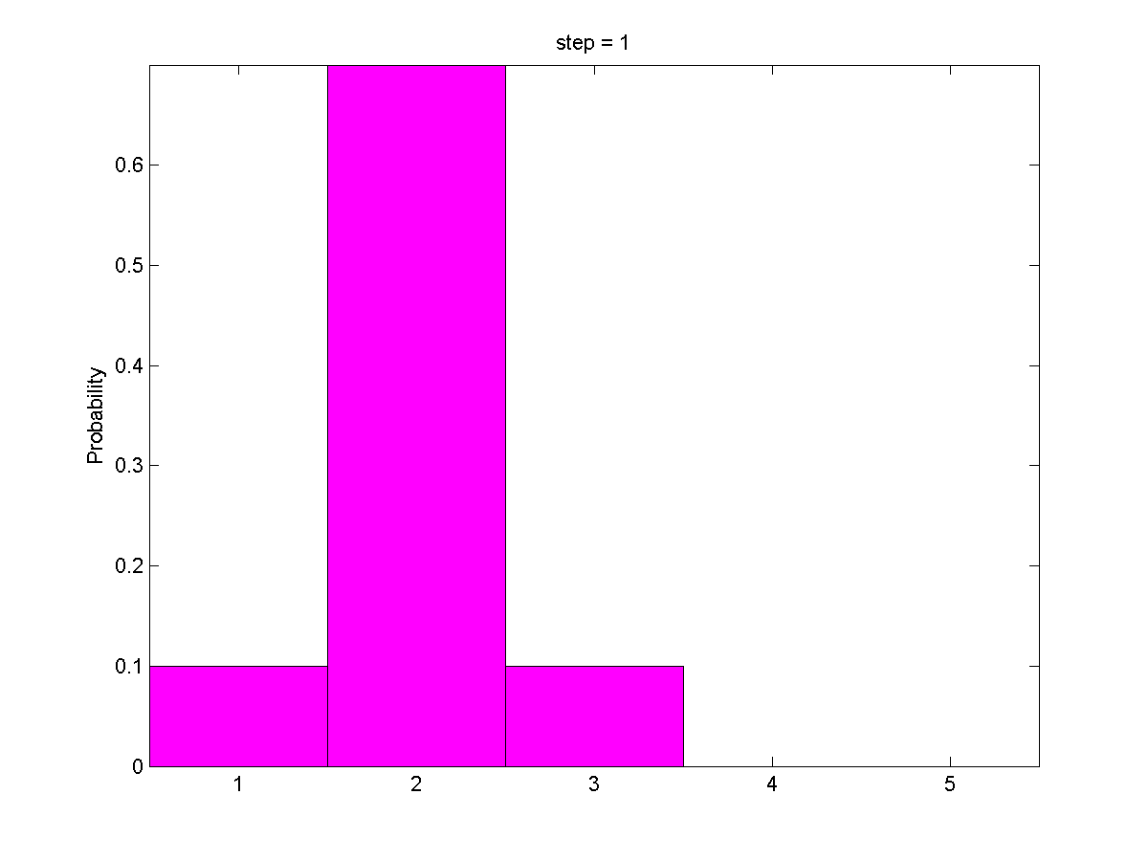

Slide 73
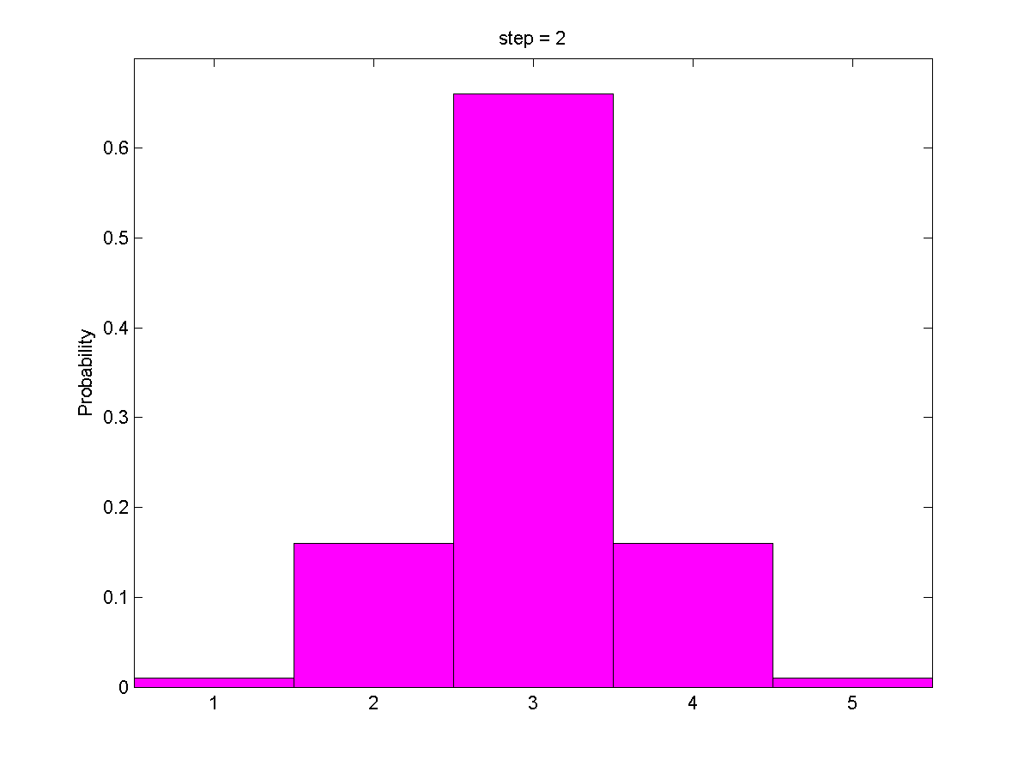

Slide 74
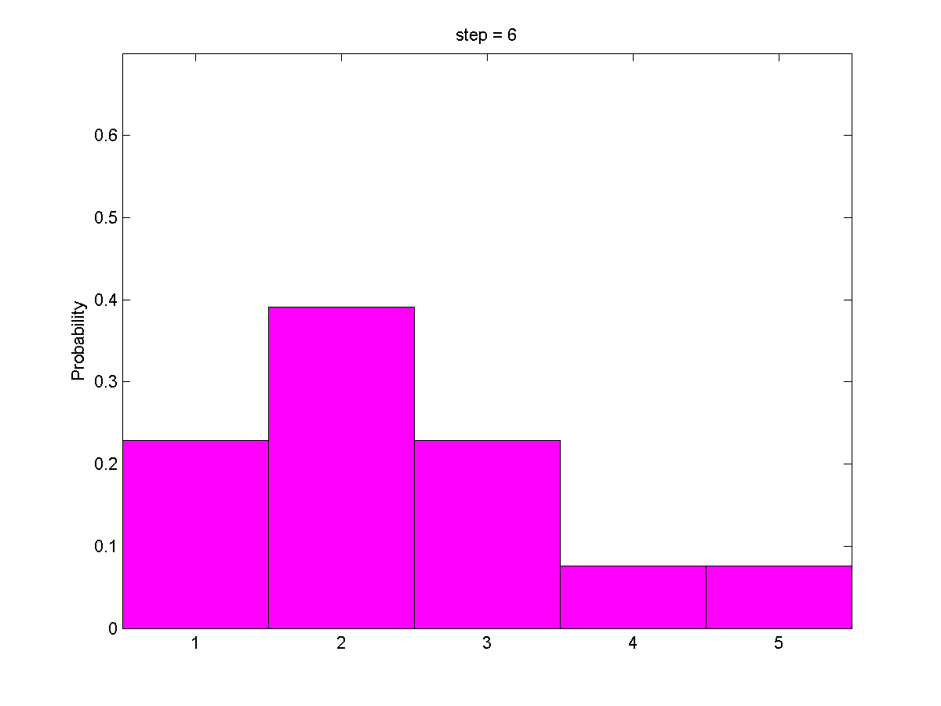

Slide 75
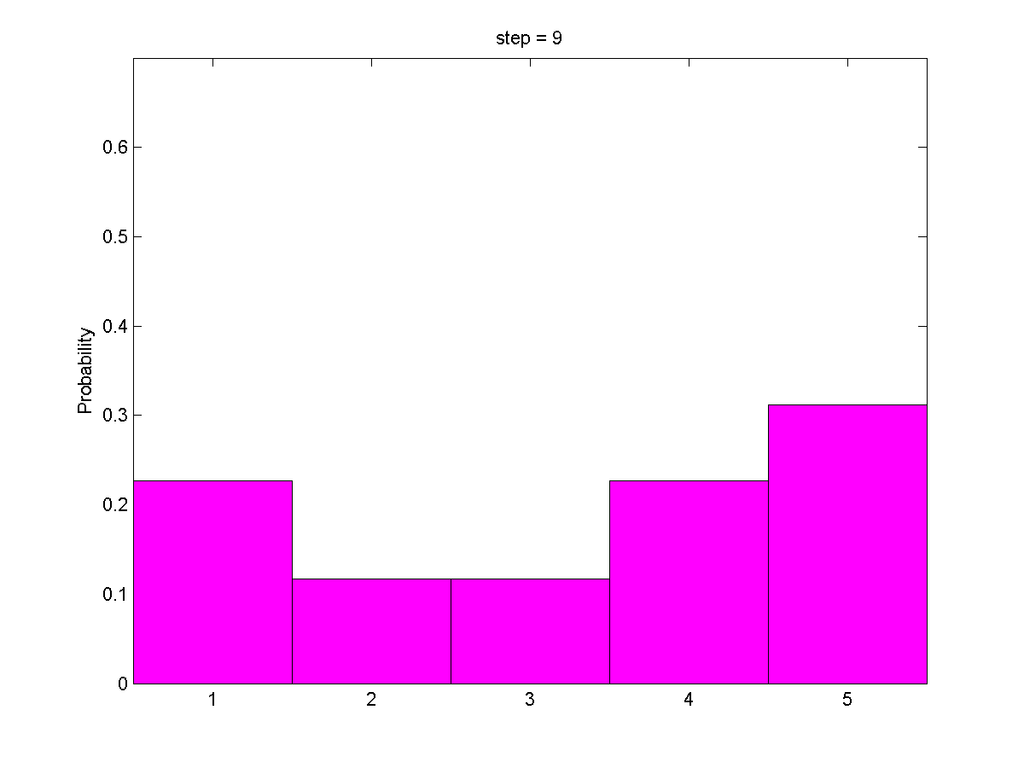

Slide 76
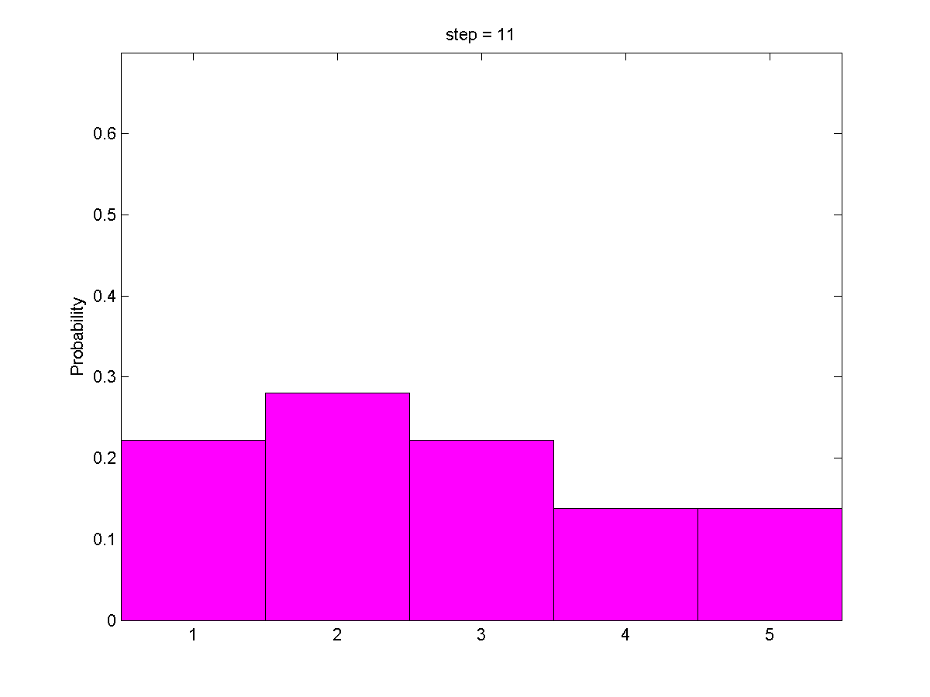

Slide 77
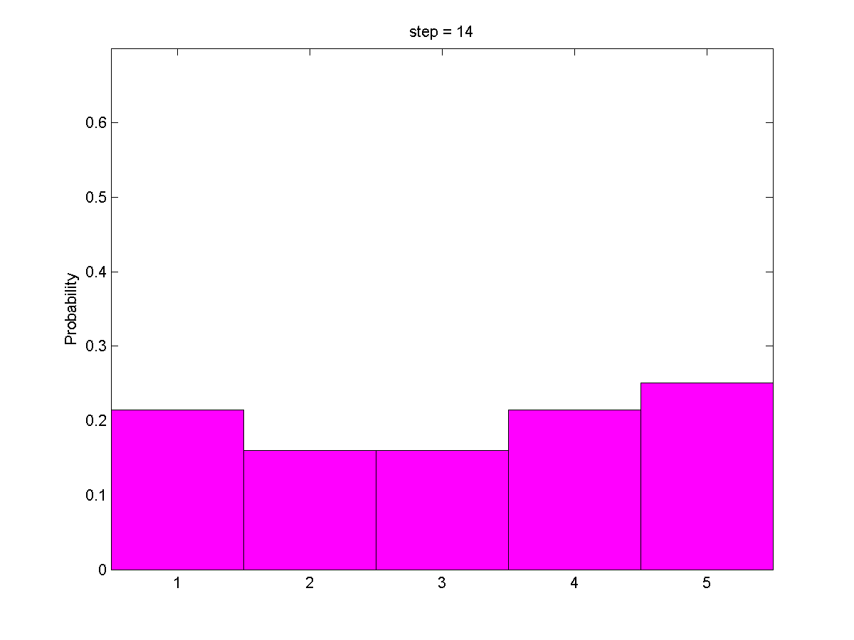

Slide 78
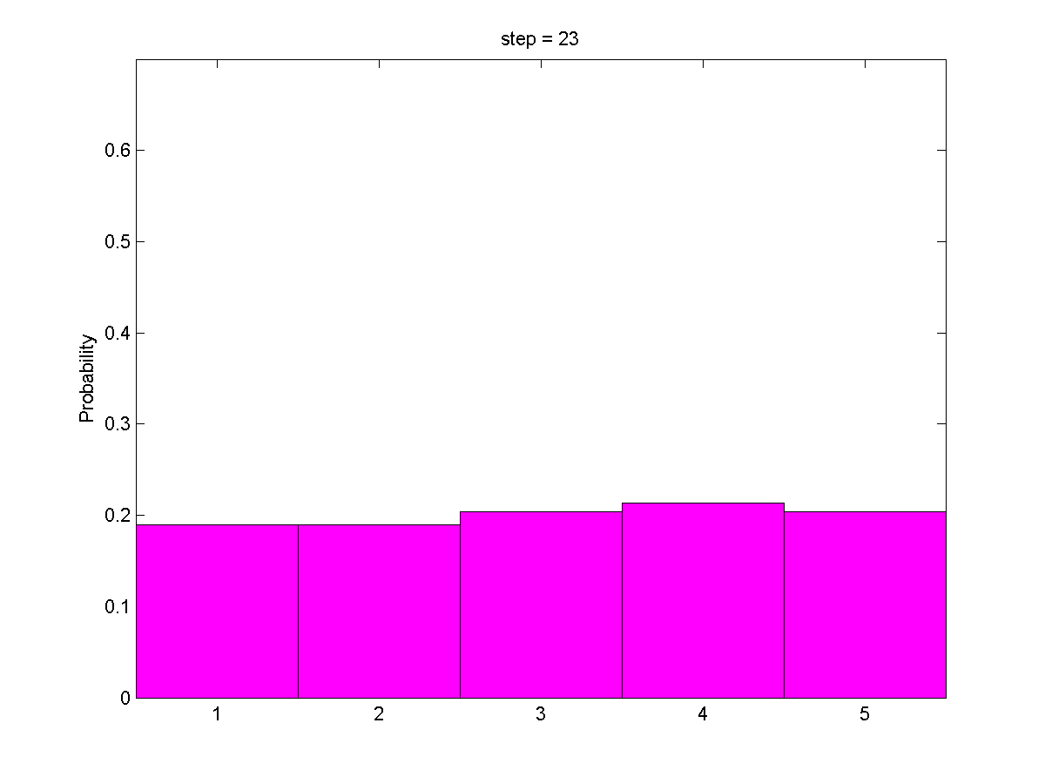

Slide 79
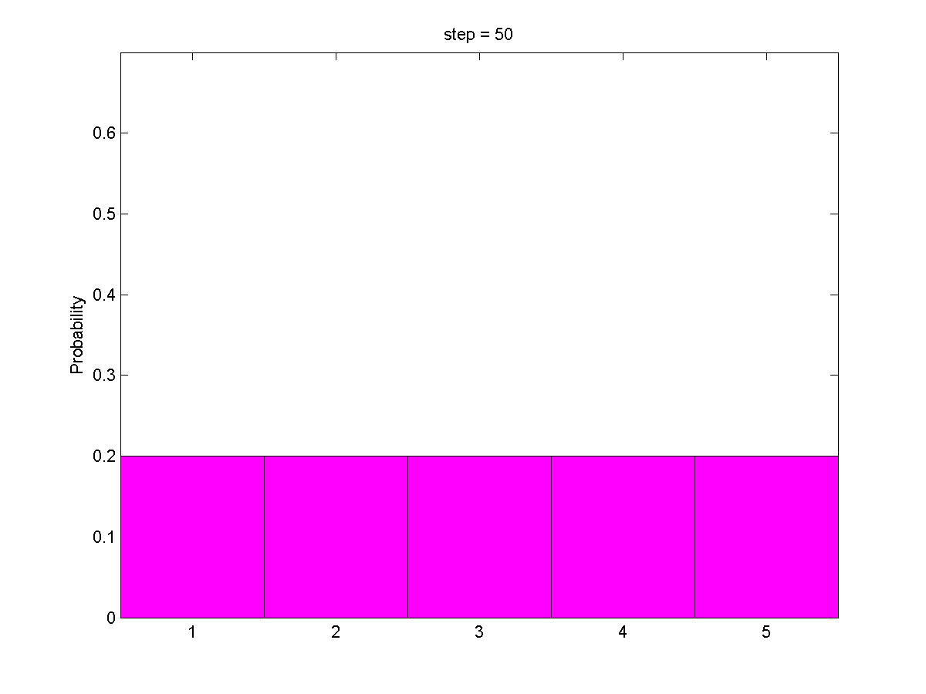

Slide 80
After 50 moves, we have lost essentially all information about the robot's location.
We need to be continuously sensing if we want to know the robot's location.

Slide 81
1
0
0
0
0
U = 1
0.2
0.2
0.2
0.2
0.2
We can also solve for the probability of each cell by realizing that each cell is the possible destination for three other cells.
It is uniform distribution!

Slide 82
Have you realized how crucial sensing is?

Slide 83
Gain information
Sense
Move
Lose information
Initial belief

Slide 84
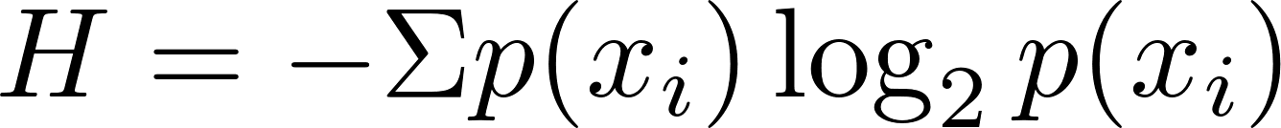

http://en.wikipedia.org/wiki/Entropy_(information_theory)
Entropy
is a measure of the uncertainty in a random variable. In this context, the term usually refers to the Shannon entropy, which quantifies the expected value of the information contained in a message.
Entropy
Informative

Slide 85
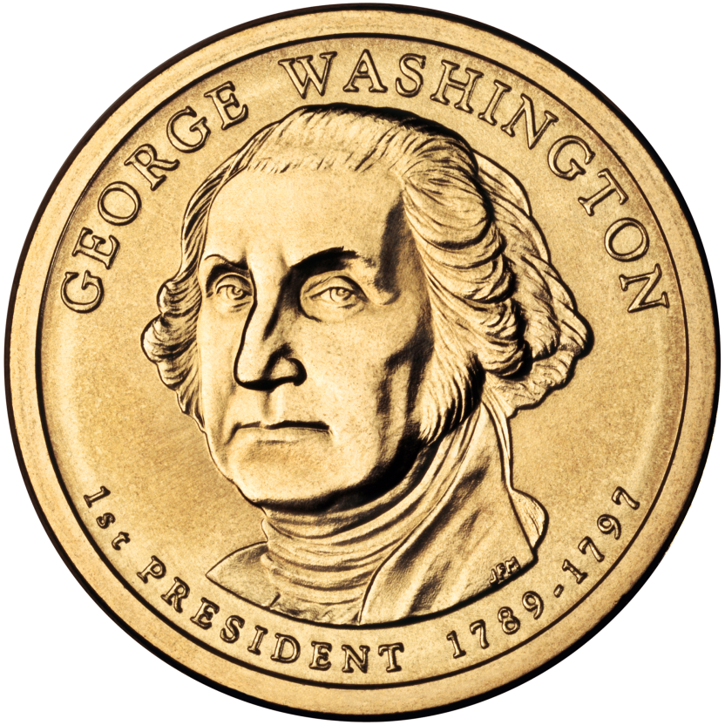
The Entropy when tossing coin
Assuming the probability of being head can be specified (0~1), what will the entropy be?
Let’s implement this！

Slide 86
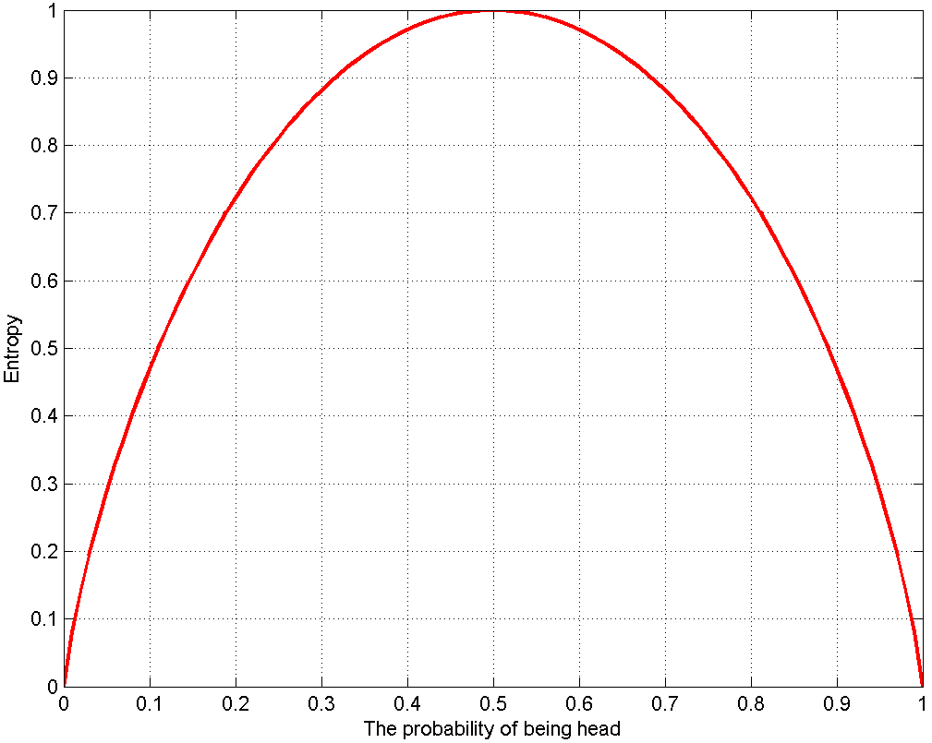

P65

Slide 87
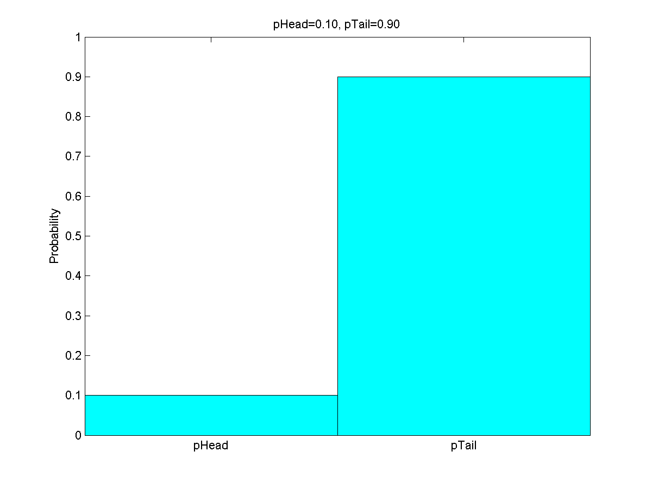



P65

Slide 88
pHead = 0 : 0.01 : 1;
n = length(pHead);
H = zeros(1, n);
for i = 1 : n
p = [pHead(i), 1 - pHead(i)];
if (pHead(i) == 0)
p = 1 - pHead(i);
elseif 1 - pHead(i) == 0;
p = pHead(i);
end
H(i) = -sum(p .* log2(p) );
if mod(pHead(i), 0.1) == 0 && pHead(i)~= 0 && pHead(i) ~= 1
htemp = figure(1);
bar(p,1);
ylim([0,1]);
set(gca, 'XTickLabel', {'pHead', 'pTail'});
ylabel('Probability');
title(sprintf('pHead=%.2f, pTail=%.2f',pHead(i),1-pHead(i)));
colormap(cool);
print(htemp,'-dpng',sprintf('phead=%.2f.png', pHead(i)));
end
end
P65

Slide 89

Which one is most uncertain?
Which one is most informative?

Slide 90
The most uncertain one
The most certain one
Informative?

Slide 91
0.4690
0.8813
1.0000

Slide 92
0.4690
0.8813
1.0000
In an estimation-theoretic context
it is most natural to think of the “most informative” probability distribution as that which assigns all probability to a single state; logically the most compact of probabilities.
Conversely, the “least informative” distribution is one in which probability is spread uniformly over all states and so entropy is a maximum.
Maximum entropy distributions are often used as prior distributions when no useful prior information is available

Slide 93
0.4690
1.0000
0.8813
Most informative
Least informative
In an estimation-theoretic context
it is most natural to think of the “most informative” probability distribution as that which assigns all probability to a single state; logically the most compact of probabilities.
Conversely, the “least informative” distribution is one in which probability is spread uniformly over all states and so entropy is a maximum.
Maximum entropy distributions are often used as prior distributions when no useful prior information is available
Entropy
Informative
Uncertainty

Slide 94
0.4690
0.8813
1.0000
In a communication context
If the result of the experiment is known with high probability a priori, then the actual occurrence of the event is not very informative.
Conversely, if the possibility of each outcome is uniformly distributed, then the outcome itself is most informative.
The outcome of a random experiment is guaranteed to be most informative if the probability distribution over outcomes is uniform.

Slide 95
0.4690
1.0000
0.8813
Least informative
Most informative
In a communication context
If the result of the experiment is known with high probability a priori, then the actual occurrence of the event is not very informative.
Conversely, if the possibility of each outcome is uniformly distributed, then the outcome itself is most informative.
The outcome of a random experiment is guaranteed to be most informative if the probability distribution over outcomes is uniform.
Entropy
Informative
Uncertainty

Slide 96
In an estimation-theoretic context
Entropy
Informative
Uncertainty
In a communication context
Entropy
Informative
Uncertainty

Slide 97

In an estimation-theoretic context
Entropy
Informative
Uncertainty
Localization complies with this rule!

Slide 98
In an estimation-theoretic context
Entropy
Informative
Uncertainty
Let’s demonstrate the rule with robot motion!

Slide 99
entropy = zeros(1, step);
for i = 1 : step
p = move(p, u, pExact, pOvershoot, pUndershoot);
entropy(i) = -sum(p .* log2(p) );
disp(i);
disp(p);
end
h = figure(1);
hold on;
plot(1:step,entropy, '-','linewidth', 2,'color', 'g');
plot(1:step,entropy, '^','linewidth', 1.5,'color', 'r');
xlabel('Motion step');
ylabel('Entropy');
print(h, '-dpng', 'entropy.png');
P7

Slide 100

Entropy
Informative
Uncertainty
P7

Slide 101
Z
Z
U = 1
U = 1
Where am I?
Which cell will robot be most probably next to after the two measurements and the two motions?

Slide 102
Z
Z
U = 1
U = 1
I am probably here!
Let’s implement this！
We find the robot most likely in right-most cell

Slide 103
p = [0.2, 0.2, 0.2, 0.2, 0.2]; % Prior
world = {'green', 'red', 'red', 'green', 'green'}; % Map
%% First configuration of meas. & motion
measurements = {'red', 'green'}; % Observation
motions = [1, 1];
%% Observation model
pHit = 0.6;
pMiss = 0.2;
%% Motion model / Process model
pExact = 0.8;
pOvershoot = 0.1;
pUndershoot = 0.1;
%% The recursive sensing and moving
entropy = zeros(2, length(motions));
for i = 1 : length(measurements)
%% Update by sensing
p = sense(p, measurements(i), world, pHit, pMiss);
entropy(1,i) = -sum(p .* log2(p) );
%% Predict by moving
p = move(p, motions(i), pExact, pOvershoot, pUndershoot);
entropy(2,i) = -sum(p .* log2(p) );
end
First configuration
P8

Slide 104

0.2116 0.1516 0.0811 0.1684 0.3874
entropy(end, end) = 2.1433
P8

Slide 105

Entropy
Informative
Uncertainty
Predict
Predict
Update
P8
entropy(end, end) = 2.1433

Slide 106


world = {'green', 'red', 'red', 'green', 'green'};
measurements = {'red', 'green', 'green'};
motions = [1, 1, 1];
Second configuration
0.4118 0.2522 0.0761 0.0515 0.2085
entropy(end, end) = 2.0030

Slide 107


world = {'green', 'red', 'red', 'green', 'green'};
measurements = {'green', 'red'};
motions = [1, 1];
Third configuration
0.1400 0.1853 0.3884 0.2021 0.0842
entropy(end, end) = 2.1445

Slide 108


world = {'green', 'red', 'red', 'green', 'green'};
measurements = {'green', 'green'};
motions = [3, 1];
Fourth configuration
0.1907 0.1645 0.1355 0.1645 0.3449
entropy(end, end) = 2.2329

Slide 109


world = {'green', 'red', 'red', 'green', 'green'};
measurements = {‘red', 'red'};
motions = [3, 1];
Fifth configuration
0.1970 0.2149 0.2582 0.2149 0.1149
entropy(end, end) = 2.2783

Slide 110

world = {'green', 'red', 'red', 'green', 'green'};
measurements = {'red', 'red'};
motions = [2, 1];
Sixth configuration
0.1970 0.1149 0.2149 0.2582 0.2149
entropy(end, end) = 2.2783

Slide 111








Configuration ID | Correctness | Sharpest peek of posterior | Final entropy | Visualization of posterior
First |  | 0.3874 | 2.1433
Second |  | 0.4118 | 2.0030
Third |  | 0.3884 | 2.1445
Fourth |  | 0.3449 | 2.2329
Fifth |  | 0.2582 | 2.2783
Sixth |  | 0.2582 | 2.2783

Slide 112
The probability distribution we pursuit should have two qualities:
It should have one sharp peak. This indicates that the robot has a very specific belief about its current location.
The peak should be correct! If this weren't true, the car would believe--very strongly--that it was in the wrong location. This would be bad .

Slide 113
That’s the essence of mobile robot localization!

Slide 114
The localization procedure can be written as a series of steps:
1. Start with a belief set about our current location.
2. Multiply this distribution by the results of our sense measurement.
3. Normalize the resulting distribution.
4. Move by performing a convolution. This sounds more complicated than it really is: this step really involved multiplication and addition to obtain the new probabilities at each

Slide 115
You may be curious about how we can use individual cells to represent a road. After all, a road isn't neatly divided into cells for us to jump between. Mathematically, we would say the road is not discrete it is continuous. Initially, this seems like a problem. Fortunately, whenever we have a situation where we don't need exact precision, we can chop a continuous distribution into pieces and make those pieces as small as we need.
To use continuous probability distributions to describe beliefs, we need Kalman filter-liked algorithms…

Slide 116
Extend 1D to 2D

Slide 117
Let’s model the 2D world as a set of colored cells.

Slide 118


Slide 119
Motion commands:
[0, 0] Keep stationary
[0, 1] Move right
[0, -1] Move left
It is also cyclic.
[1, 0] Move down
[-1, 0] Move up

Slide 120
The motion is executed correctly at a probability of 0.8. When the motion fails, the robot won’t move at all
[0, 0] Keep stationary
[0, 1] Move right
Let’s implement this！
[0, -1] Move left
[1, 0] Move down
[-1, 0] Move up

Slide 121
world = {'red', 'green', 'green', 'red' , 'red';
'red', 'red', 'green', 'red', 'red';
'red', 'red', 'green', 'green', 'red';
'red', 'red', 'red', 'red', 'red'}; % Map
nRow = size(world, 1);
nCol = size(world, 2);
pStart = 0.7;
p = (1 - pStart) / (nRow * nCol-1) * ones(nRow, nCol);% Prior
p(3, 2) = pStart;
stop = [0, 0];
right = [0, 1];
left = [0,-1];
down = [1, 0];
up = [-1,0];
motions = {right};
pMoveCorrect = 0.8;
q = move(p, cell2mat(motions(1)), pMoveCorrect);
P9

Slide 122
function q = move(p, u, pMoveCorrect)
nRow = size(p, 1);
nCol = size(p, 2);
q = zeros(nRow, nCol);
for r = 1 : nRow
for c = 1 : nCol
q(r, c) = pMoveCorrect * ...
p(mod(r-1-u(1), nRow) + 1, mod(c-1-u(2), nCol) + 1)...
+ (1 - pMoveCorrect) * p(r, c);
end
end
end
function [r, c] = maxMat(g)
% Find the index of the largest element of g
[temp,r] = max(g);
[~,c] = max(temp);
r = r(c);
end
P9

Slide 123
The Prior:
0.0150 0.0150 0.0150 0.0150 0.0150
0.0150 0.0150 0.0150 0.0150 0.0150
0.0150 0.7000 0.0150 0.0150 0.0150
0.0150 0.0150 0.0150 0.0150 0.0150
The probability after moving:
0.0150 0.0150 0.0150 0.0150 0.0150
0.0150 0.0150 0.0150 0.0150 0.0150
0.0150 0.1520 0.5630 0.0150 0.0150
0.0150 0.0150 0.0150 0.0150 0.0150
The largest probability 0.5630 occurs at cell (3, 3)

Slide 124

P9

Slide 125

P9

Slide 126
The Prior:
0.0150 0.0150 0.7000 0.0150 0.0150
0.0150 0.0150 0.0150 0.0150 0.0150
0.0150 0.0150 0.0150 0.0150 0.0150
0.0150 0.0150 0.0150 0.0150 0.0150
The probability after moving:
0.0150 0.0150 0.1520 0.0150 0.0150
0.0150 0.0150 0.0150 0.0150 0.0150
0.0150 0.0150 0.0150 0.0150 0.0150
0.0150 0.0150 0.5630 0.0150 0.0150
The largest probability 0.5630 occurs at cell (4, 3)

Slide 127


Slide 128


Slide 129
The sensor measurement is correct at a probability of 0.7
Let’s implement this！

Slide 130
function q = sense(p, z, world, pSenseCorrect)
nRow = size(p, 1);
nCol = size(p, 2);
q = zeros(nRow, nCol);
for r = 1 : nRow
for c = 1 : nCol
hit = strcmp(z, world(r, c));
q(r, c) = p(r, c) *...
(hit * pSenseCorrect + (1-hit) * (1 - pSenseCorrect));
end
end
q = q / sum(sum(q));
end
pSenseCorrect = 0.7;
q = sense(p, cell2mat(measurements(1)), world, pSenseCorrect);
measurements = {'green'};
P10

Slide 131
The Prior:
0.0150 0.0150 0.0150 0.0150 0.0150
0.0150 0.0150 0.0150 0.0150 0.0150
0.0150 0.7000 0.0150 0.0150 0.0150
0.0150 0.0150 0.0150 0.0150 0.0150
The probability after sensing:
0.0138 0.0323 0.0323 0.0138 0.0138
0.0138 0.0138 0.0323 0.0138 0.0138
0.0138 0.6452 0.0323 0.0323 0.0138
0.0138 0.0138 0.0138 0.0138 0.0138
P10

Slide 132
motions = {stop, right, down, down, right};
measurements = {'green', 'green', 'green' ,'green', 'green'};
Move
Sense
Which cell will robot be most probably at after these motions and measurements?

Slide 133
motions = {stop, right, down, down, right};
measurements = {'green', 'green', 'green' ,'green', 'green'};
Move
Sense
The robot will be at cell (3, 4)
Let’s implement this！

Slide 134




Move
Sense

Slide 135


The Posterior:
0.0111 0.0246 0.0680 0.0447 0.0247
0.0072 0.0102 0.0870 0.0799 0.0094
0.0074 0.0089 0.1127 0.3535 0.0407
0.0091 0.0072 0.0143 0.0431 0.0364
The largest probability 0.3535 occurs at cell (3, 4)

Slide 136

Entropy
Informative
Uncertainty
Update
Predict
P11

Slide 137
pMoveCorrect = 0.8;
pSenseCorrect = 0.7;
compEntropy = inline('-sum(sum(p .* log2(p)))'); % Inline function
p = 1 / (nRow * nCol - 1) * ones(nRow, nCol); % Prior
%% Fisrt configuration
motions = {stop, right, down, down, right};
measurements = {'green', 'green', 'green' ,'green', 'green'};
%% Check the size
if length(motions) ~= length(measurements)
error('The variable ''motions'' should be of the same size as ''measurements''!');
end
entropy = zeros(2, length(motions));
%% The main loop
for i = 1 : length(motions)
p = move(p, cell2mat(motions(i)), pMoveCorrect);
p0 = p;
p = sense(p, cell2mat(measurements(i)), world, pSenseCorrect);
%% Compute entropy
entropy(:, i) = [compEntropy(p0); compEntropy(p)];
end
%% Locate the final cell
[r, c] = maxMat(p);
fprintf('The largest probability %.4f occurs at cell (%d, %d)\n ',...
p(r,c), r, c);
P11

Slide 138

Histogram filter

Slide 139

Histogram Demo
http://veterobot.com/
An open sourced and 3D printed robot

Slide 140
Assignment 2
Give a presentation covering following topics:
Bayes filter
Mathematical derivation of Bayes filter
2. Preview/Review P1-P8 following this slides.
The talk shouldn’t be longer than 15 minutes.
Involving some coding-based simulations is better.

Slide 141
Assignment 3
Give a presentation covering following topic:
Circular convolution
2. Share your understanding of P8.
The talk shouldn’t be longer than 15 minutes.
Involving some coding-based simulations is better.

